Slide 1
Taylor McKenzie

Slide 2
Background
Received Ph.D. in Economics from the University of Oregon in 2017
Focus in industrial organization and econometrics
Efficiency analyses (technical and allocative)
Structural modeling of pricing and economies of scale
Experience interning at Pacific Northwest National Laboratory
Disease modeling
Nuclear proliferation pathway analysis
Social media analytics
Social network analysis for cyber vulnerabilities
Currently a Senior Cybersecurity Researcher at Sandia National Laboratories

Slide 3
Risk, Resilience, and Vulnerability Analysis
Motivating question: How can weaknesses in a system affect its mission?
Risk analysis: Threats (from any source), vulnerability to those threats, and consequence
Resilience analysis: Vulnerability to a specific threat, consequence; focus on system’s ability to withstand and quickly recover from disruption
Vulnerability analysis: Specific consequence of concern and vulnerabilities that can lead to that consequence
Notes:
Something other than “weaknesses”
For resilience, systems can always be exploited

Slide 4
Red Teaming
Vulnerability analysis often takes the form of red teaming
Red teaming: Assuming the role of an adversary to identify vulnerabilities and their consequence
There are many flavors of red teaming
Sandia’s main red teaming effort is unique in a few ways
Information Design Assurance Red Team (IDART)
Considers a realistic adversary
An adversary would not launch a sophisticated attack to break into your home wireless network
Considers a realistic attack path, including a combination of cyber and physical actions
Why do something the hard way?
Documents the process and areas of improvement
Notes:
Key points:
Many red teams hit a target with relatively sophisticated attacks (regardless of the target), focus solely on one vector (e.g., cyber), and only aim to break into the system (not show how it was done or what could be done generally to improve)
Sandia focuses on developing rules of engagement
Reference for IDART

Slide 5
IDART Process
Identify consequences of concern (nightmare scenarios)
Select a model of a realistic adversary, including skills and tolerance for risk
Collect information about the system, including potential weaknesses and attack vectors
Identify and document easiest (low effort, low likelihood of detection) attack paths that result in consequences of concern
(Optional) Demonstrate attack paths to show feasibility

Slide 6
IDART Process
Identify consequences of concern (nightmare scenarios)
Select a model of a realistic adversary, including skills and tolerance for risk
Collect information about the system, including potential weaknesses and attack vectors
Identify and document easiest (low effort, low likelihood of detection) attack paths that result in consequences of concern
(Optional) Demonstrate attack paths to show feasibility

Slide 7
Nightmare Consequences
For information systems, consequences/capabilities measured in terms of¹
Confidentiality: Ability to protect information from unauthorized access
Integrity: Ability to protect information from unauthorized changes
Availability: Ability to provide access to system or services when requested
(Less frequently) Accountability: Ability to track actions on a system and assign them to specific actors²
(Less frequently) Assurance: Ability to trust metrics and analysis system to ensure it performs its mission
Nightmare consequence examples
Systems that store personal information: Confidentiality
Power system: Availability
Power system information/control infrastructure: Integrity
Web server: Availability
1. See Stoneburner (2001) for more details.
2. For example, see RAND Report 2395: Olympic-Caliber Cybersecurity
Notes:
Power system: Integrity; spoofing system state or changing SCADA commands (e.g., generator set point)
Add in 2001 reference from RAND report
Confidentiality: OPM breach
Power system availability: NERC issued $10 million in fines due to Duke Energy’s cyber risk

Slide 8
Consequences More Generally
For other projects/applications, we want to quantify consequence impact beyond “the worst thing that can happen”
These consequences may be less understood by decision-makers (e.g., system-level impacts)
It may be difficult to determine exactly how consequences propagate
It can be difficult/impossible to numerically quantify consequences, necessitating qualitative measures
Involved in a few projects that dealt with these issues
Notes:
More than just nightmare scenarios, want to quantify consequence for any threat/vulnerability.
Can be done quantitatively if data exist
Can also be done qualitatively (as in CSA or NETCOM project).
For NETCOM, we categorized low-level metrics then determined how those mapped into CIA for the system as a whole.
For CSA, we categorized based on industry.

Slide 9
Projects Quantifying Consequence: Network simulation
Quantifying resilience of enterprise network to various cyber attacks
Able to simulate network and observe system-level values (e.g., latency, connectivity, uptime)
System-level values are noisy
Difficult to understand exactly how system-level impacts affect ability to perform mission
Decision-makers need higher-level information
Performed state estimation to estimate true values
Deliberated with team and people familiar with system to convert system-level metrics to higher levels
Measures of confidentiality, integrity, and availability for services/capabilities provided by system
Measures of ability to perform specific actions given system attributes

Slide 10
IDART Process
Identify consequences of concern (nightmare scenarios)
Select a model of a realistic adversary, including skills and tolerance for risk
Collect information about the system, including potential weaknesses and attack vectors
Identify and document easiest (low effort, low likelihood of detection) attack paths that result in consequences of concern
(Optional) Demonstrate attack paths to show feasibility

Slide 11
Adversary Models: Generic Threat Matrix
For IDART, hypothetical adversaries are qualitatively scored along six dimensions¹
Intensity: Risk tolerance for getting caught and negative consequences
Stealth: Ability to maintain secrecy through attack
Time: Amount of adversary is willing to spend planning, developing, and deploying attack
Technical personnel: Size of technical team
Knowledge: Level of cyber and other knowledge possessed by adversary
Access: Ability to access facility or system, either by opportunity, force/coercion, or insider assistance
A fuzzy match of the hypothetical adversary to the threat matrix determines threat level (1-High to 8-Low)
This is a subjective, deliberative process, often end up with more than one possible categorization
1. See SAND Report 2007-5791: Categorizing Threats for more details
Notes:
Currently working to develop more rigorous adversary models using SME survey data

Slide 12
Generic Threat Matrix
Threat Level | Threat Profile
 | Commitment |  |  | Resources
 | Intensity | Stealth | Time | Technical Personnel | Knowledge |  | Access
 |  |  |  |  | Cyber | Kinetic
1 | H | H | Years to Decades | Hundreds | H | H | H
2 | H | H | Years to Decades | Tens of Tens | M | H | M
3 | H | H | Months to Years | Tens of Tens | H | M | M
4 | M | H | Weeks to Months | Tens | H | M | M
5 | H | M | Weeks to Months | Tens | M | M | M
6 | M | M | Weeks to Months | Ones | M | M | L
7 | M | M | Months to Years | Tens | L | L | L
8 | L | L | Days to Weeks | Ones | L | L | L

Slide 13
Analysis to Select Adversarial Model
We have been working to make this process less subjective, taking our deliberation out of the process, and relying more on subject matter expertise
For physical systems, we have surveyed subject matter experts over a variety of dimensions/capabilities do determine what is required to overcome given security measures (skill/tolerance for risk)
Previous (deliberative) methodology can/has produced aggregate ratings for these scenarios; can use variant of ordered probit or similar to predict aggregate rating of future scenarios/adversaries
Advantages
Resulting predictions are on same scale as past ratings
Disadvantages/difficulties
Technical difficulty: Link function for ordered probit is nonlinear; constrained kernel smoothing can help
Resulting predictions are (partially) dependent on past ratings
Also considering variant of probabilistic clustering without relying on past subjective aggregation
Relies on subject matter experts with cross-domain knowledge
Notes:
Work with Greg on combining SME ratings
Key point: We want to aggregate because we don’t want to confine ourselves to very specific type of adversary; want a general class of adversaries

Slide 14
Analysis to Select Adversarial Model
Notes:
Work with Greg on combining SME ratings
Key point: We want to aggregate because we don’t want to confine ourselves to very specific type of adversary; want a general class of adversaries

Slide 15
IDART Process
Identify consequences of concern (nightmare scenarios)
Select a model of a realistic adversary, including skills and tolerance for risk
Collect information about the system, including potential weaknesses and attack vectors
Identify and document easiest (low effort, low likelihood of detection) attack paths that result in consequences of concern
(Optional) Demonstrate attack paths to show feasibility

Slide 16
System Information and Weaknesses
Key takeaway: There are frequently differences between how people think a system is configured vs. how it is actually configured
Misunderstanding of terms
Outdated system information
Plan vs. implementation
Asking the right questions, asking in several different ways
Examples:
“Our system is air-gapped”
How do you update software on your system?
Can employees check their personal email? How do you read the news?
Is the same account information used on internal (air-gapped) and external (not air-gapped) networks?
Network diagram vs. network map results

Slide 17
IDART Process
Identify consequences of concern (nightmare scenarios)
Select a model of a realistic adversary, including skills and tolerance for risk
Collect information about the system, including potential weaknesses and attack vectors
Identify and document easiest (low effort, low likelihood of detection) attack paths that result in consequences of concern
(Optional) Demonstrate attack paths to show feasibility

Slide 18
Attack Paths
Key assumption: An adversary will not do something difficult or easily detectable if the same result can be accomplished by doing something easy or less detectable
Example: No need to produce completely realistic badge or use an insider if you can just walk in the door
Example: Launch zero-day exploit to infiltrate network or dress up as IT support and use social engineering to gain physical access to servers?
Basic strategy
Find a large open wall and post-its
Starting points on one side, nightmare consequences on the other
Brainstorm steps at any point in the attack sequence based on ideas/expertise
Prune steps that are too difficult for adversary model or more difficult than other steps that accomplish same result
Chain together steps to create attack path
Detailed and complete information about the system is critical
May require some iteration

Slide 19
IDART Process
Identify consequences of concern (nightmare scenarios)
Select a model of a realistic adversary, including skills and tolerance for risk
Collect information about the system, including potential weaknesses and attack vectors
Identify and document easiest (low effort, low likelihood of detection) attack paths that result in consequences of concern
(Optional) Demonstrate attack paths to show feasibility

Slide 20
Demonstrating Attack Paths
Main goal: Show it’s possible to make a nightmare consequence happen under the adversarial model
Showmanship/cool factor never hurts
Many clients think attacks have to be sophisticated
Showing them an attack can be easy gets them thinking other low-hanging fruit
We like to perform assessments in design phase; red-team mentality becomes ingrained in design process

Slide 21
IDART Takeaways
Real-life security measures are often not as advanced as expected
Attacks do not need to be sophisticated to be successful
Security measures tend to focus on one area, leaving open other attack vectors
Frequent differences between design plan and implementation

Slide 22
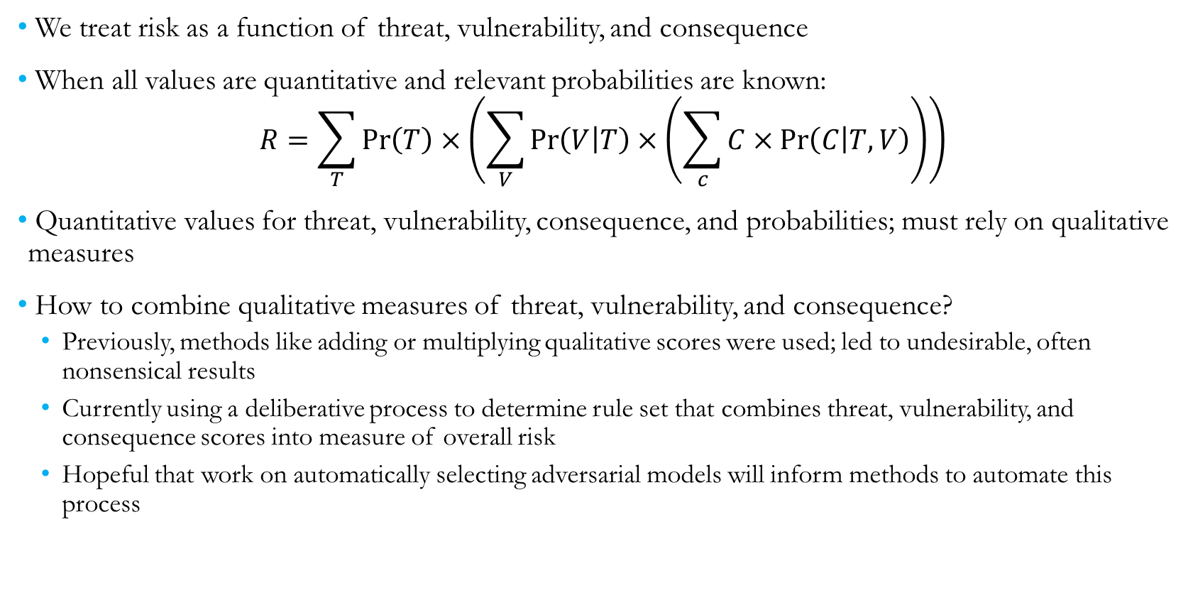
Assessing Risk as a Whole
We treat risk as a function of threat, vulnerability, and consequence
When all values are quantitative and relevant probabilities are known:
$$R=\sum_{T}{\operatorname{Pr}\left(T\right)×\left(\sum_{V}{\operatorname{Pr}\left(V | T\right)×\left(\sum_{c}{C×\operatorname{Pr}\left(C | T,V\right)}\right)}\right)}$$
Quantitative values for threat, vulnerability, consequence, and probabilities; must rely on qualitative measures
How to combine qualitative measures of threat, vulnerability, and consequence?
Previously, methods like adding or multiplying qualitative scores were used; led to undesirable, often nonsensical results
Currently using a deliberative process to determine rule set that combines threat, vulnerability, and consequence scores into measure of overall risk
Hopeful that work on automatically selecting adversarial models will inform methods to automate this process

Slide 23
Qualitative Risk Assessment: Prioritizing Improvements
The Cyber Security Advisor (CSA) group under the Department of Homeland Security performs cybersecurity assessments with the goal of improving security measures for high-risk organizations
CSA has relatively limited resources, wanted a method and tool to prioritize engagements (conferences, industry working groups, etc.)
We focused on measuring risk and the likelihood that engagements will lead to eventual assessments
Likelihood of successful engagement could be assessed quantitatively using historical assessment data
Some problems with endogeneity and separating effects (e.g., is an advisor particularly successful, or do most engagements with a particular industry lead to assessments?)
Relied on qualitative measures of threat/vulnerability and consequence
Developed initial method of combining measures into overall risk
Polled CSA with hypothetical engagements, asked them to score each component and overall risk
Used for improving and validating methodology
Notes:
Was going to put CSA here, but would fit better in overall risk quantification

